Slide 1
Tree ADT
CPSC 131 - Data Structure
Shrinivas Patil

Slide 2
Tree
Hierarchical structure
Collection of nodes connected by edges
Consist of central node, structural nodes and sub nodes
7
1
4
8

Slide 3
Recall: Doubly-Linked List Node
DLL: each element is in a node
Each doubly-linked list node has
One element
Prev pointer
Next pointer
Visualize as a horizontal line of nodes
4
7
1
4
dummy

Slide 4
Basic Tree Terminology (Family tree concepts)
Binary tree terminology is a mixed metaphor
Family tree, arboreal tree, altitude
Parent of node x: directly above x
Child of node x: directly below x
Either left child or right child
Ancestor of node x: x, or x’s parent, or their parent, or their parent, etc.
Descendant of node x: x, or x’s child, or their child, or their child, etc.
size=4 root
7
1
4
8

Slide 5

Basic Tree Terminology (Arboreal concepts)
7
Arboreal: having to do with plant trees
Analogy works with an upside-down arboreal tree
1
4
8
Root: topmost node
All nodes are descendants of the root
Root has no ancestors besides itself
Leaf: node with no children
Bottom of the tree
Leaf has no descendants besides itself

Slide 6
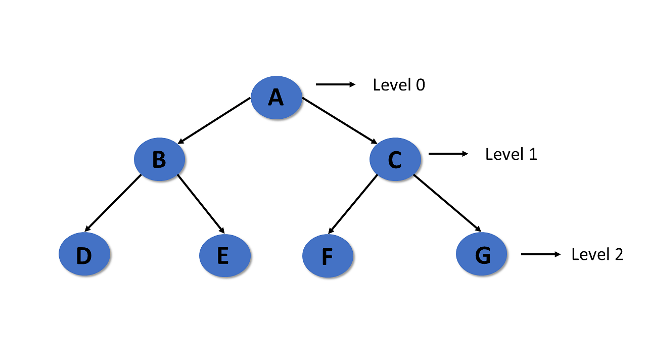
Level
In tree data structures, the root node is said to be at level 0, and the root node's children are at level 1, and the children of that node at level 1 will be level 2, and so on.

Slide 7
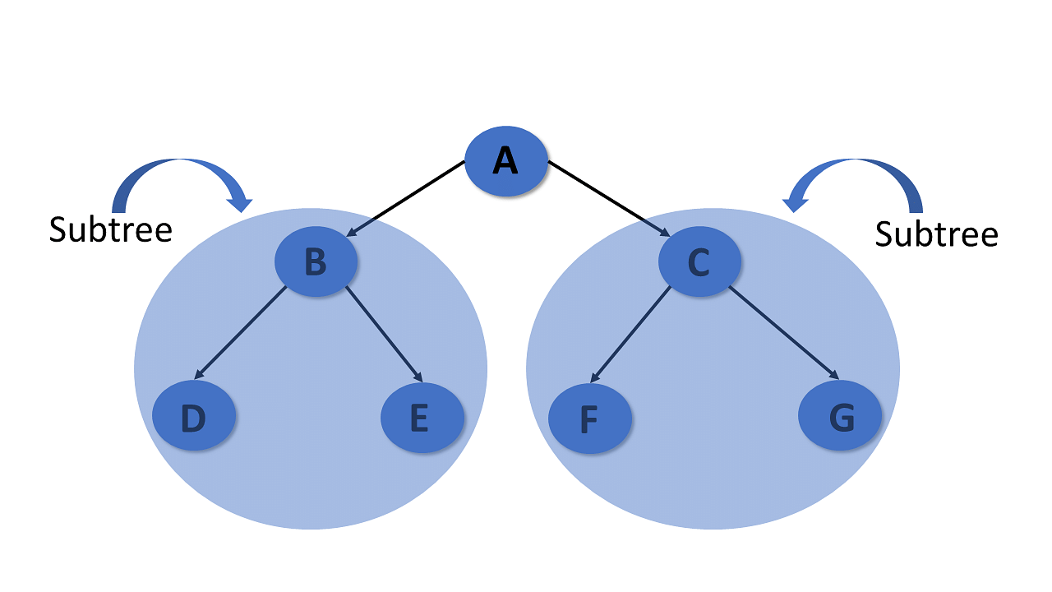
Subtree
In the tree, each child from a node shapes a sub-tree recursively and every child in the tree will form a sub-tree on its parent node.

Slide 8
Altitude Terminology
size=4 root
depth
height
0
7
2
Depth of node x:
Number of edges between x and the root
Root has depth 0
1
1
1
1
4
0
Height of node x:
Maximum number of edges between x and a leaf
Leaf has height 0
Null child has height -1
Parent has height 1 + max(left child’s height, right child’s height)
Height of entire tree: height of root node
2
8
0
tree height = 2

Slide 9
Types of tree
Binary Tree:
Each tree node has maximum 2 children nodes. The two children are left and right.
Ternary Tree
Each tree node has maximum 3 children nodes. The 3 children are left, mid and right.
N-nary Tree
Generic tree
each node is a data structure that consists of records and a list of references to its children

Slide 10
Analyzing Binary Tree Height
Soon: binary search tree efficiency relates to height
Define n = number of nodes in tree
Define h = height of tree
Q: what is the maximum and minimum possible height of a binary tree as a function of n?

Slide 11
Maximum Height is O(n)
Imagine stretching out a tree vertically
Tall, narrow tree
Every parent has only one child
All left children, or
All right children, or
A mix (zig-zag)
4
4
4
3
3
3
2
2
2
1
1
1
0
0
0
Height h = n-1
Maximum height is O(n)

Slide 12
Minimum Height
Imagine “smooshing” together tree vertically
Short, wide tree
Every parent has two children
Let’s draw such trees and observe the relationship between n and h

Slide 13
Minimum Height
0
# nodes n | Height h
1 | 0

Slide 14
Minimum Height
1
# nodes n | Height h
1 | 0
3 | 1
0
0

Slide 15
Minimum Height
2
# nodes n | Height h
1 | 0
3 | 1
7 | 2
1
1
0
0
0
0

Slide 16
Minimum Height
3
# nodes n | Height h
1 | 0
3 | 1
7 | 2
15 | 3
2
2
1
1
1
1
0
0
0
0
0
0
0
0
Pattern: n = 2^{h+1} - 1

Slide 17
Minimum Height - Solve for h
n = 2^{h+1} - 1
n+1 = 2^{h+1}
Take log₂ of both sides:
log₂ (n+1) = log₂ (2^{h+1})
log₂ (n+1) = (h+1)
(log₂ (n+1)) - 1 = h
h = (log₂ (n+1)) - 1 ≈ log₂ n
In computer science, log x ≝ log₂ x, so
h is O(log n)

Slide 18
Binary Tree Height Bounds
n = number of nodes
h = height
Maximum possible height: h is O(n)
Minimum possible height: h is O(log n)
Soon: this is where O(log n) time efficiency comes from

Slide 19
Basic Tree Operations
Insert
Delete
Search
Traversal
Preorder
Inorder
Postorder

Slide 20
Euler Tour
Euler: prolific mathematician
Euler tour: counter-clockwise “shoreline” around tree
Way of visualizing, defining, tree traversal
3 moments when we could visit each node:
Left side = before both children = preorder
Under = between children = inorder
Right side = after both children = postorder
7
1
4
8

Slide 21
Preorder
Preorder: visit node when Euler tour reaches the left side of the node
(Before both children)
Preorder traversal of example graph: 7, 1, 8, 4
Application: printing tree to stdout
7
1
4
8

Slide 22
Inorder
Inorder: visit node when Euler tour reaches the underside of the node
(After left child, before right child)
Inorder traversal of example graph: 8, 1, 7, 4
Application: iterate through nodes in left-to-right order
7
1
4
8

Slide 23
Postorder
Postorder: visit node when Euler tour reaches the right side of the node
(After both children)
Postorder traversal of example graph: 8, 1, 4, 7
Application: freeing all nodes
Have to free parent after both children
7
1
4
8

